Slide 1
B1 REVISION – CHAPTER 1 – KEEPING HEALTHY
What are the 7 components of a healthy diet?
.
.
.
.
.
.
.
Describe the issues with being overweight
Describe the issues with being underweight
What does it mean to be malnourished?
How does the body control cholesterol levels?
What is the link between health and exercise?
What are the different methods of infection?
What are the differences between bacteria and viruses?
What are antibiotics?
How do they work?
How do our bodies defend against disease?
KEY WORDS:
Malnourished
Metabolic rate
Overweight
Obese
Infectious disease
Microorganism
Pathogens
Viruses
Bacteria
Immune system
Antibiotics
Epidemic
Pandemic
Immunisation
Vaccination
ASSESSMENT:

Slide 2
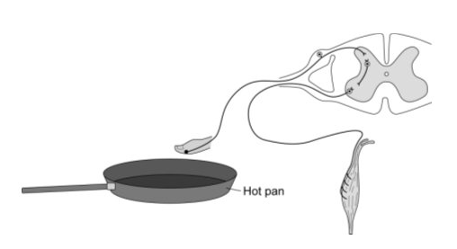
B1 REVISION – CHAPTER 2 – COORDINATION AND CONTROL
Name the five sense organs:
.
.
.
.
.
Fill in the blanks:
Receptor → _________ _________→_________ _________ → _________ _________ → effector
Describe the reflex arc shown in this diagram
What is the menstrual cycle?
Describe how the hormones of the menstrual cycle interact?
FSH
Oestrogen
Progesterone
LH
Draw a diagram of geotropism in roots and shoots:
How are the following conditions controlled:
Temperature:
Blood sugar
Water and ions:
KEY WORDS:
Nervous system
Impulses
Stimuli
Receptors
Neurone
Reflex arc
Synapse
Menstrual cycle
Hormones
Contraceptive
Interval environment
Homeostasis
Photosynthesis
Tropisms
ASSESSMENT:

Slide 3
B1 REVISION – CHAPTER 3 – MEDICINE & DRUGS
What are the features of a good medicine?
What are drugs?
Why are some legal and others illegal?
What is the difference between prescribed and non-prescribed drugs?
How are new medicines developed?
What is a double-blind trial?
What are performance enhancing drugs?
Is it ethical to use performance enhancing drugs?
Describe the issues with thalidomide
Describe the issues with cannabis
KEY WORDS:
Effective
Safe
Stable
Double-blind trial
Placebo
Thalidomide
Statins
Depression
Withdrawal symptoms
Legal
Illegal
Steroids
ASSESSMENT:

Slide 4
B1 REVISION – CHAPTER 4 – ADAPTATION FOR SURVIVAL
How are plants adapted to different environments?
How are animals adapted to different environments?
What do plants compete for and why?
What do animals compete for and why?
How can plants and animals be used to measure environmental change?
KEY WORDS:
Adaptations
Carnivore
Herbivore
Extremophiles
Surface area : volume ratio
Stomata
Respiration
Competition
Territory
ASSESSMENT:

Slide 5
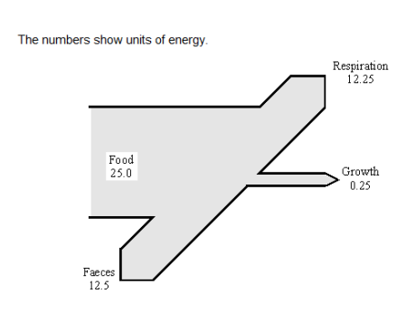
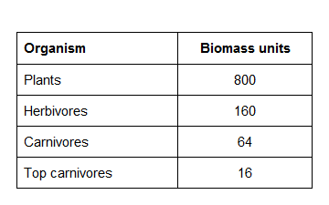
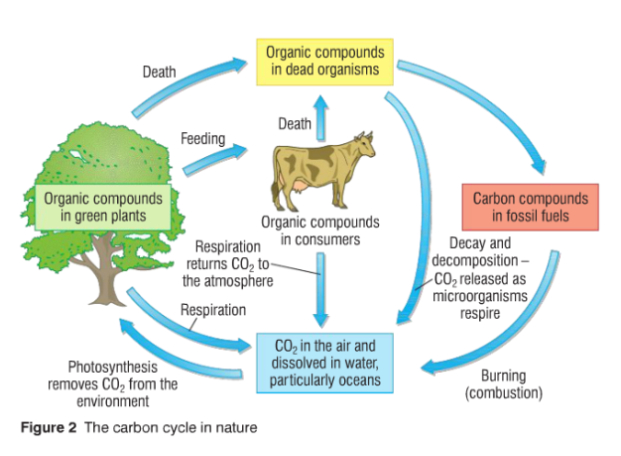
B1 REVISION – CHAPTER 5 – ENERGY IN BIOMASS
What is a pyramid of biomass?
Sketch a pyramid of biomass for this food chain:
Fill in this Sankey diagram to show energy loss:
Show your working here:
Faeces:
What is are the conditions needed for decay?
How does the decay process recycle nutrients?
Fill in the gaps in the carbon cycle
KEY WORDS:
Biomass
Pyramid of Biomass
Decomposers
Detritus feeders
Sewage treatment plants
Compost heap
Fossil fuels
Carbon cycle
Combustion
Organic waste
Green house gases
ASSESSMENT:

Slide 6
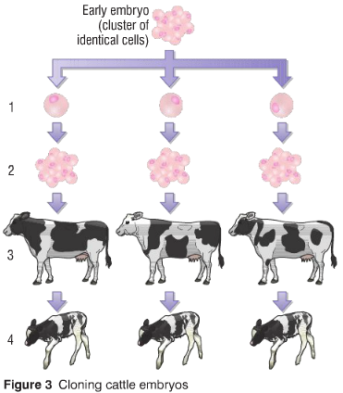
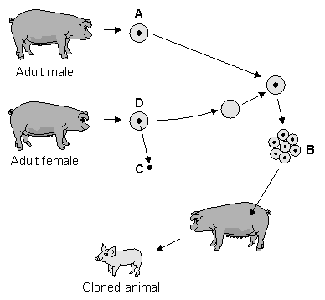
B1 REVISION – CHAPTER 6 – VARIATION, REPRODUCTION & NEW TECH
Define these key words:
Inheritance:
Genes:
Chromosomes:
DNA:
What is nature versus nurture?
Explain these two types of cloning:
Embryonic Cloning:
Adult Cell Cloning:
Fill in the gaps to explain genetic engineering of insulin:
The first step in the biotechnological process is that a special enzyme is used to cut the insulin ..................................... out from a human ............................................. . In a separate operation, a ring of bacterial ............................................... is cut open using a special enzyme. These two pieces of genetic material are combined together to form a new plasmid ring which is inserted into a bacterium.
What is sexual reproduction?
What is asexual reproduction?
KEY WORDS:
Genes
Gametes
Chromosomes
DNA
Sexual / asexual reproduction
Clones
Tissue culture
Genetically modified
Genetic engineering
ASSESSMENT:

Slide 7
B1 REVISION – CHAPTER 7 – EVOLUTION
What is the theory of evolution?
What is classification?
What is Jean-Baptiste Lamarck’s theory of evolution?
What an evolutionary tree?
What is Charles Darwin’s theory of evolution?
Explain how the peppered moth shows evolution in action?
What is survival of the fittest?
KEY WORDS:
Evolution
Jean-Baptiste Lamarck
Inheritance of acquired characteristics
Charles Darwin
Survival of the fittest
Mutation
Classification
Natural selection
Kingdoms
Species
ASSESSMENT:

Slide 8
B2

Slide 9
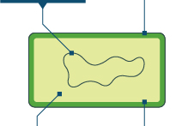
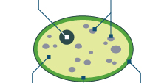
B2 REVISION – CHAPTER 1 – CELLS
What do plant cells have that animal cells do not?
What is the function of:
Nucleus –
Mitochondria
Ribosome
Chloroplasts
Cell Wall
Sketch and label a plant and an animal cell;
Use pictures and words to describe how substances can move in and out of cells by diffusion
Label the yeast and bacteria and write 4 bullet points about the characteristics of each one
Draw and label 2 specialised cells. Explain their structure is adapted to suit their function
KEY WORDS:
Describe the difference between aerobic and anaerobic respiration in yeast

Slide 10
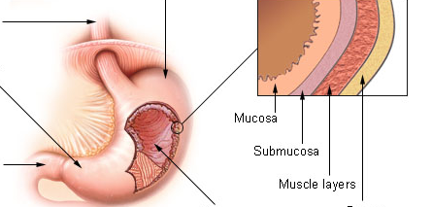
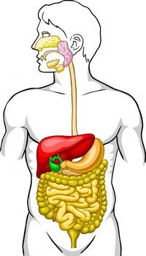
B2 REVISION – CHAPTER 1 – Tissues, organs and organ systems
A tissue is ____________________
____________________________
What is an organ?
What are the main organs of a plant?
Tissue | Function | Animal/Plant
Glandular
Epithelial
Epidermal
Mesophyll
Xylem
phloem
Label the image below and explain the function of each tissue
What is an organ system?
The digestive system’s function is
Label the diagram> For each organ describe the function it performs
cells
--------
---------------------
------------
-----------------
Adaptations for exchange – For each one of the organs below write down the substance that is exchanged
Lungs:
Small intestine:
Kidneys
Make a list of the adaptations you may see on these organs:
-
-
-

Slide 11
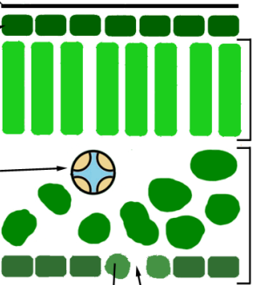
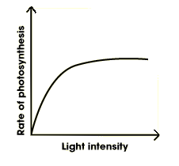
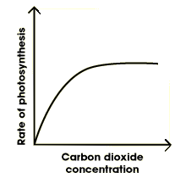
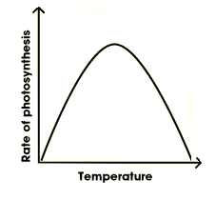
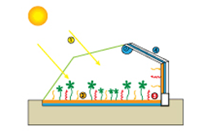
B2 REVISION – CHAPTER 2 – HOW PLANTS PRODUCE FOOD
What is the equation for photosynthesis
Where in the plant does it occur?
How are leaves adapted to perform photosynthesis?
Label the different tissues in the leaf and explain their function:
Explain how plants use glucose for the following:
Respiration
Building up molecules
Storage
Explain how light, CO₂ and temperature are limiting factors of photosynthesis
Why do farmers want their plants to do as much photosynthesis as possible?
Label the diagram below to explain which factors are being controlled? What is hydroponics?
Notes:
11

Slide 12
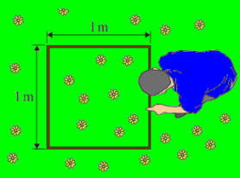
B2 REVISION – CHAPTER 2 – Organisms in their environment
Physical Factor | How does it affect organisms?
Temperature
Nutrients
Amount of light
Availability of water
O2 and CO2 availability
Key definitions:
Mean:
Median:
Mode:
Reproducible data:
Valid data:
Quadrats
What is a quadrat?
What do we use it for?
What do you do to get valid results?
Is it random?
Transects
What is the most common type of transect?
What do we use a transect for?
Explain how do you use a transect
Is it random?
Notes:
12

Slide 13
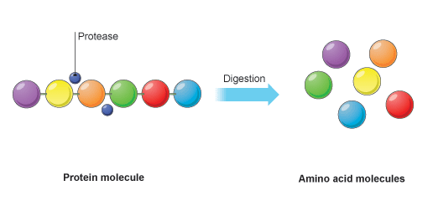
B2 REVISION – CHAPTER 3 – ENZYMES
What are enzymes made from?
What do enzymes do?
How do they work? (explain & draw the lock & key mechanism
Enzymes in industry
What are the advantages and disadvantages of using enzymes?
Biological detergents
What are biological detergents?
How are these other enzymes used in industry:
Proteases:
Carbohydrases:
Isomerases:
Enzymes in medicine
What are the 3 groups of enzymes in digestion? What is their substrate and what do they break them down into?
Proteases – break down proteins
into amino acids
2)
3)
Why is the stomach acidic?
What is bile? Explain where it is produced and its functions.
Advantages
Disadvantages
Pros | Cons
What effect does temperature have on enzyme activity
What effect does pH have on enzyme activity
To diagnose disease
To control disease
To cure disease:
Notes:
13

Slide 14
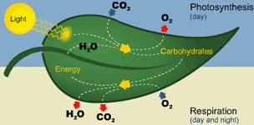
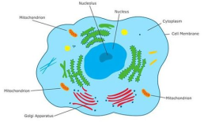
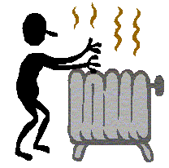
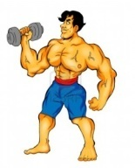
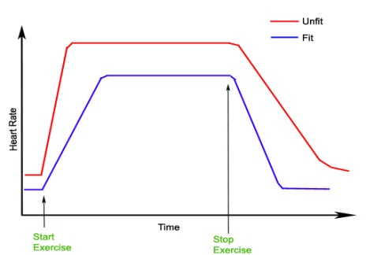
B2 REVISION – CHAPTER 4 – ENERGY FROM RESPIRATION
Write down the equation for aerobic respiration:
Key concept
Remember that plants do photosynthesis AND respiration
Respiration is controlled by e ________________
It takes place all the time in a___________ and p________________.
Is called aerobic respiration because it uses o______________
Respiration takes place in the m________________.
Reasons for respiration
Write down the equation for anaerobic respiration:
Where and when does anaerobic respiration take place?
Why do muscles become fatigued if you exercise hard?
Why is anaerobic respiration much more inefficient than aerobic?
What is oxygen debt?
The fit person has a ______________resting heart rate, before they begin to exercise
The fit persons heart rate rises more ______________
The maximum heart rate reached by the fit person is a lot __________________than the unfit person
The fit persons heart rate drops ____________when they finish exercise
The heart rate of the fit person returns to their resting heart rate in a _________________time.
The response to exercise:
Heart rate →
Breathing rate →
Notes:
14

Slide 15
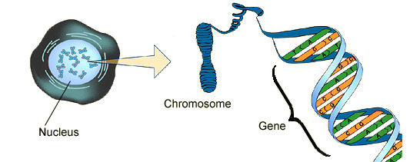
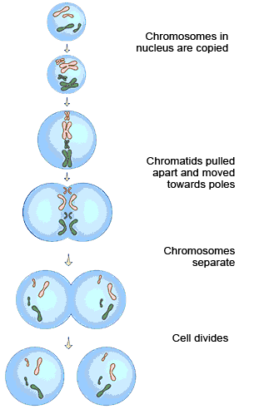
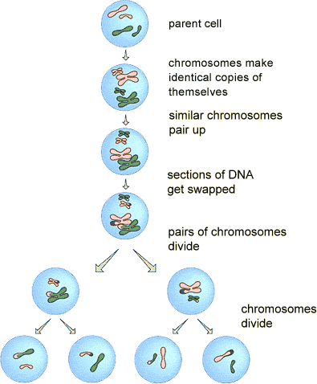
B2 REVISION – CHAPTER 5 – Cell Division and Growth
Labe l the diagram:
A gene is a section of D____. It controls a c____________ of your body. You have ___ chromosomes in the n______ of your b_______ cells. Arranged in _____ pairs. One of each pair is inherited from your m________ and one from your f_________. Your sex cells or g_________ only have _____ chromosomes.
Other key terminology:
Differentiation:
Fertilisation:
Variation:
Stem cells
Future of stem cell research
Function
Uses
Problems
What is the name of this process?
Write down an explanation of what is happening at each stage in the boxes.
How many daughter cells produced?
Are the genes identical or different to parental cell?
Why and where do cells undergo mitosis?
A mnemonic for mitosis:
“Mitosis goes on in my toes, and toes are not sexy”
What is the name of this process?
Write down an explanation of what is happening at each stage in the boxes.
How many daughter cells produced?
Are the genes identical or different to parental cell?
Why and where do cells undergo meiosis?
Notes:
15

Slide 16
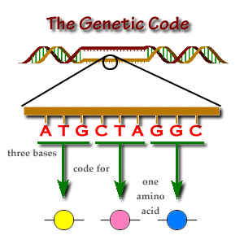
B2 REVISION – CHAPTER 5 – INHERITANCE
Key terms in genetics
Inheritance of Cystic Fibrosis
Type of allele :
Symptoms:
Treatment:
Draw a genetic diagram to show the inheritance of this condition (two parents carriers)
Write a paragraph about Gregor Mendel and his work
Homozygous
Heterozygous
Genotype
Phenotype
Allele
Genetic disorder
Carriers
The genetic code. Explain how the order of the DNA bases determines the order of the amino acids in a protein.
Inheritance of Polydactyly
Type of allele :
Symptoms:
Treatment:
Draw a genetic diagram to show the inheritance of this condition (Pp x pp)
Inheritance of Huntington's disease
Type of allele :
Draw a genetic diagram to show the inheritance of this condition (Hh x hh)
Two men claim to be the father of the same child. Explain how DNA fingerprinting can be used to find out which one is the real father.
What is genetic screening? What are the main ethical issues?
Notes:
16

Slide 17
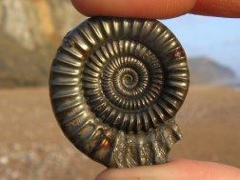
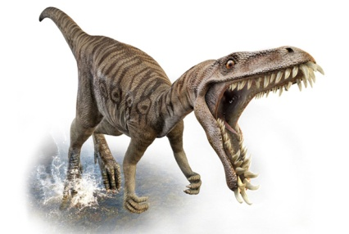
B2 REVISION – CHAPTER 6 – OLD AND NEW SPECIES
What is a fossil?
What is extinction?
Extinction caused by living organisms:
New predators:
New diseases
Successful competition:
Geographical isolation:
Endemic:
Explain how fossils can be formed
Hard parts
No decay
Traces
Replacement
SPECIATION
Extinction caused by environmental changes
Sexual reproduction and mutation
Population with a wide range of alleles
As a result the features of the isolated population will slowly change
Natural selection
Organism dies and falls to the ground
Why is the fossil record not complete?
Geographical isolation
What is mass extinction:
Dinosaurs extinction theories:
Speciation
Notes:
17

