Slide 2
good
venue
arena
promotion
better
technical
facilities
management
theatre
adequate
publicity
best
accessible
business
proessional
choreographer

Slide 3
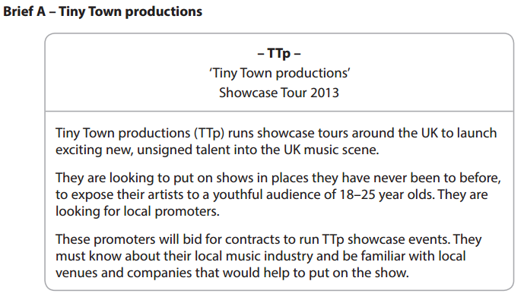
2015
Sample questions
[8 marks]

Slide 4
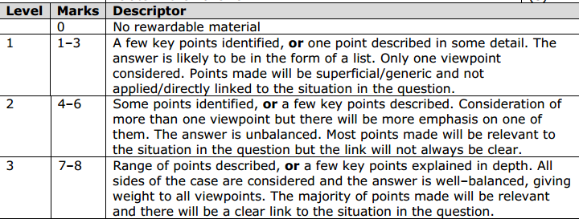
How to get the marks
Include points linked to the question.
Include detailed (explained) points.
Include points for both sides (advantages and disadvantages).

Slide 5
Create a balanced response for top marks
advantages
disadvantages
1
2
1
2
Discuss
advantages
disadvantages

Slide 6
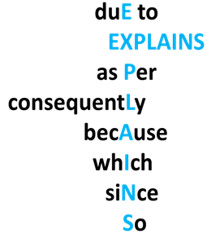
Formula for 8 mark response
Advantages
Point linked to question
Explanations
x3/4
Explain
Disadvantages
Point linked to question
Explanations
x3/4
Explain
You will need 3/4 explained points for advantages and disadvantages

Slide 7
A sample of what part of the formula looks like
A disadvantage could be if the marketing company do not perform well this could consequently have a negative impact on Joe’s reputation as a promoter.
Explain
Shows you are linking your point to the situation in the question.
Explain
Shows you are explaining your point.
Shows you are creating a balanced response (ensure you have both advantages as well as disadvantages).

Slide 8
Can you identify the parts of the formula?
Music Unit 1 model answer with formula.docx
One advantage is the marketing company are likely to have more experience of designing promotional materials and strategy, resulting in a reliable, professional service.
Because the marketing company are local, the advantage is the established connections with the local music scene, including: access to local suppliers, e.g. graphic designers, printers, leafleting. This will result in the bid being more relevant to the local area.
Another advantage is the marketing company are likely to have knowledge of interrelation between local networks, including musicians, promoters, marketing, venues, studios and broadcasters, which could result in better communication between the promoter and the networks.

Slide 9
However, a disadvantage could be the marketing company may want too much control in strategies and decision making, resulting in a loss of creative control for Joe.
Also, the marketing company may take a large cut of the promoter’s fee, which is a disadvantage reducing Joe’s profit.
Finally, another disadvantage is that Joe will have missed the opportunity to build his own reputation and get his name better known, because the marketing company will take responsibility for any success.

Slide 10
Answers

Slide 11
One advantage is the marketing company are likely to have more experience of designing promotional materials and strategy, resulting in a reliable, professional service.
Because the marketing company are local, the advantage is the established connections with the local music scene, including: access to local suppliers, e.g. graphic designers, printers, leafleting. This will result in the bid being more relevant to the local area.
Another advantage is the marketing company are likely to have knowledge of interrelation between local networks, including musicians, promoters, marketing, venues, studios and broadcasters, which could result in better communication between the promoter and the networks.
Explain
Explain
Explain

Slide 12
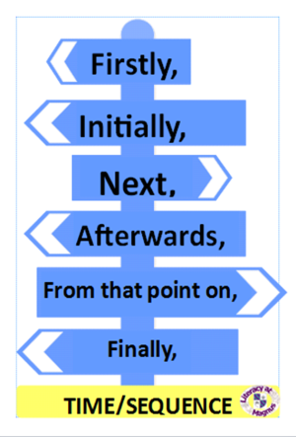
Signal the start of the disadvantages to show your balanced response.
However, a disadvantage could be the marketing company may want too much control in strategies and decision making, resulting in a loss of creative control for Joe.
Also, the marketing company may take a large cut of the promoter’s fee, which is a disadvantage reducing Joe’s profit.
Finally, another disadvantage is that Joe will have missed the opportunity to build his own reputation and get his name better known, because the marketing company will take responsibility for any success.
Explain
Explain
Explain
Signal the ending of your response using a time discourse marker

Slide 13
Attachments
Music Unit 1 model answer with formula.docx

